Slide 1
Help!
Student Health and Human Services
Office of Human Relations, Diversity & Equity
Notes:
Please feel free to encourage student participation whichever way you are most comfortable: in the Zoom chat, on a previously shared Jamboard, in break out groups, or all together in a grid view. There will be a lot of opportunities for participation throughout this presentation.

Slide 2
Welcome!
What is something that you consider yourself to be very good at?
Notes:
Invite the students to share (however you choose) something they consider themselves to be very good at as a quick warm up.

Slide 3
Objectives
Explore help seeking and help giving behaviors
Reflect on your own ideas about asking for help
Learn best practices for asking for help
Discuss how to be a helper
Notes:
Read the objectives to the students

Slide 4
People are hard-wired to be helpful
Helping others may boost
Mood
Self-Esteem
Sense of Belonging
Notes:
Read the slide for the students. Explain that it is human nature to be helpful

Slide 5
Reflection
Share about the last time you helped someone.
Notes:
Encourage the students to share about the last time they helped someone. If students have trouble coming up with examples, ask the following questions:
Did you help with chores at home?
Do you help a friend with their homework?
Why do people help each other?
Teacher:
Choose whatever platform you like for students to reflect on helping. They could find examples of helping on google image.
Focus on how it makes us feel good to help someone else.

Slide 6
Asking for help: not human nature
People are hardwired to want to do things on their own – to be independent minded.
There are many reasons why asking for help makes people feel uneasy
I get embarrassed.
I don’t want to be judged
They might say "no"
Notes:
Tell the students that it even though humans are hardwired to help, it is NOT human nature to ask for help. Rather, people are hardwired to want to do things on their own – to be more independent minded. Review the 3 reasons listed as to why it may be difficult to ask for help.

Slide 7
Reflection
Do you ever ask for help?
Notes:
Transition to help seeking behavior.
Help seeking is an important life skill. Help-seeking helps us overcome difficulties in life.

Slide 8
USE ALL YOUR STRENGTH
Notes:
debrief

Slide 9
Reflection
Why do you think the speaker continued to say "use all your strength?"
Notes:
Invite the students to reflect on why the speaker continued to say "use all your strength'.

Slide 10
NORMALIZING ASKING FOR HELP
Notes:
Share the video with the students.

Slide 11
Best ways to ask for help
In person (34% more likely to get a "Yes")
Be specific
Be direct
Be positive
Be understanding
Notes:
Review these best practices for asking for help. Time permitting, invite the students to engage in role play to practice asking for help using these criteria.

Slide 12
Reflection
What is something you could ask for help with?
Notes:
Invite the student to share their ideas about specific things they could ask for help with.

Slide 13
Check out
If you could be an expert at something, what would you want to be an expert at?
Notes:
Teacher: chose whatever platform you like for the check out.
Extension – have the students keep a list of times they helped someone, witnessed an act of helping, or engaged in their own help seeking behavior.

Slide 14
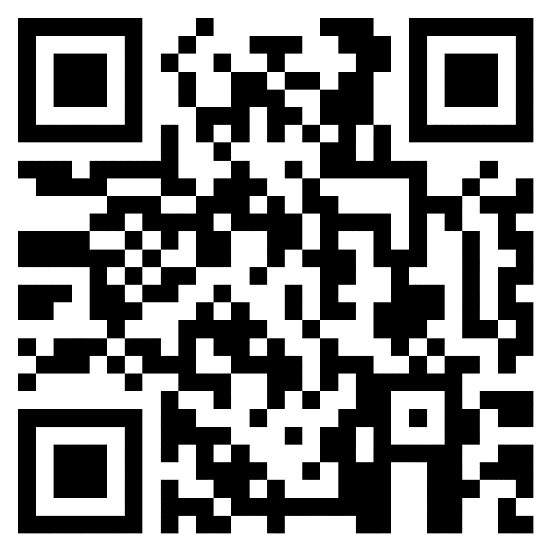
Teacher Feedback Survey
Notes:
Teacher please complete the feedback survey by scanning the QR code or clicking the link below:
https://forms.office.com/r/i9UqyyxzTT

Slide 15
Human Relations, Diversity & Equity

